Slide 1
Behavioral Science Theory and Scientific Management Theory
Anil Tiwari
K.R. Dahal
Sulav Nepal

Slide 2
Scientific Management Theory
also known as the mathematical or quantitative approach.
origin in military science.
developments taking place in computer and information technology have extended the application of this approach.
opened new frontiers for managers.
provides managers with plenty of decision making tools and techniques.

Slide 3
Job specialization
Adam Smith, 18th century economist, found firms manufactured pins in two ways:
1) Craft : each worker did all steps.
2) Factory : each worker specialized in one step.
Smith found that the factory method had much higher productivity.
- each worker became very skilled at one, specific
task.
Breaking down the total job allowed for the division of labour.

Slide 4
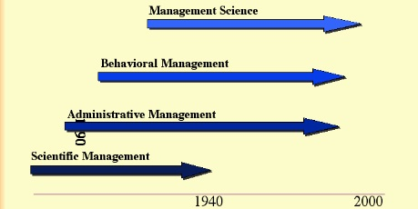
Evolution of Management Theory

Slide 5
The 4 Principles
Four Principles to increase efficiency:
Study the way the job is performed now & determine new ways to do it.
- Gather detailed, time and motion information.
- Try different methods to see which is best.
Codify the new method into rules.
- Teach to all workers.
Select workers whose skills match the rules set in step 2.
Establish a fair level of performance and pay for higher performance.
- Workers should benefit from higher output.

Slide 6
Problems of Scientific Management
ignores people and relationships in an organization.
cannot be substitute for sound judgement and other skills of managers.
ignores environmental factors.
many aspects of management cannot be modeled.

Slide 7
Conclusion
focuses on applying mathematical models and processes to management situations.
deals specifically with the development of mathematical models to aid in decision making and problem solving.
focuses more directly on the application of management science to organizations.
This theory has been very useful in the planning and controlling processes.
cannot predict the behaviour of people in orgarnizations.

Slide 8
Thanking you.
Anil Tiwari
K.R. Dahal
Sulav Nepal

